Slide 1
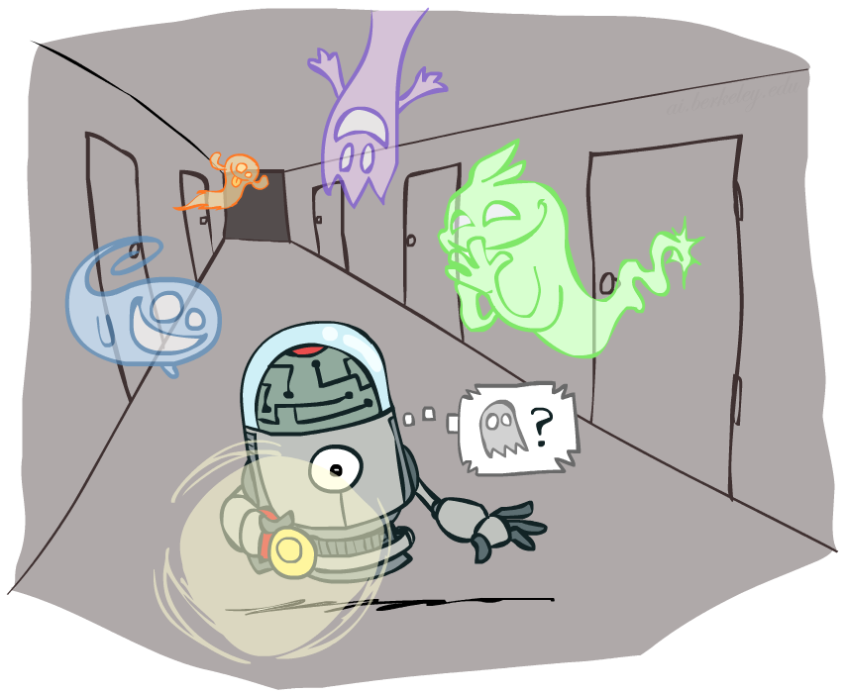
CSE 317: Artificial Intelligence
Hidden Markov Models
[These slides were created by Dan Klein and Pieter Abbeel for CS188 Intro to AI at UC Berkeley. All CS188 materials are available at http://ai.berkeley.edu.]
Notes:
Please retain proper attribution, including the reference to ai.berkeley.edu. Thanks!

Slide 2
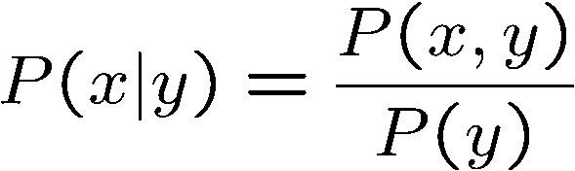

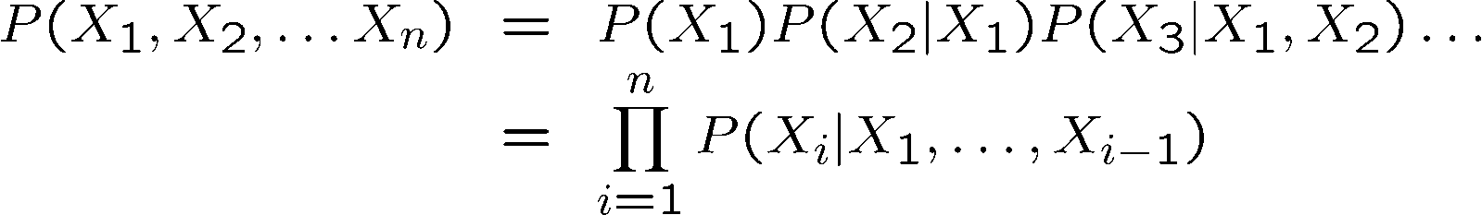

Probability Recap
Conditional probability
Product rule
Chain rule
X, Y independent if and only if:
X and Y are conditionally independent given Z if and only if:

Slide 3

Hidden Markov Models

Slide 4
Hidden Markov Models
Markov chains not so useful for most agents
Need observations to update your beliefs
Hidden Markov models (HMMs)
Underlying Markov chain over states X
You observe outputs (effects) at each time step
X₁
X₂
X₃
X₄
X₅
E₁
E₂
E₃
E₄
E₅

Slide 5


Example: Weather HMM
Rain_{t-1}
Rain_{t}
Rain_{t+1}
Umbrella_{t-1}
Umbrella_{t}
Umbrella_{t+1}
An HMM is defined by:
Initial distribution:
Transitions:
Emissions:
R_{t} | R_{t+1} | P(R_{t+1}|R_{t})
+r | +r | 0.7
+r | -r | 0.3
-r | +r | 0.3
-r | -r | 0.7
R_{t} | U_{t} | P(U_{t}|R_{t})
+r | +u | 0.9
+r | -u | 0.1
-r | +u | 0.2
-r | -u | 0.8
Notes:
demo

Slide 6

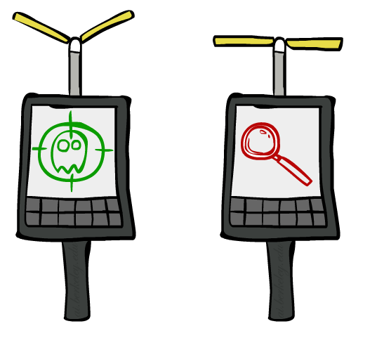
Example: Ghostbusters HMM
P(X₁) = uniform
P(X|X’) = usually move clockwise, but sometimes move in a random direction or stay in place
P(R_{ij}|X) = same sensor model as before: red means close, green means far away.
1/9
1/9
1/9
1/9
1/9
1/9
1/9
1/9
1/9
P(X₁)
1/6
1/6
1/2
0
1/6
0
X₁
X₂
X₃
X₄
0
0
0
X₅
P(X|X’=<1,2>)
R_{i,j}
R_{i,j}
R_{i,j}
R_{i,j}
[Demo: Ghostbusters – Circular Dynamics – HMM (L14D2)]
Notes:
Dan has some demo for this.

Slide 7
Joint Distribution of an HMM
X₁
X₂
X₃
X₅
E₁
E₂
E₃
E₅
Joint distribution:
More generally:
Questions to be resolved:
Does this indeed define a joint distribution?
Can every joint distribution be factored this way, or are we making some assumptions about the joint distribution by using this factorization?

Slide 8
Chain Rule and HMMs
X₁
X₂
X₃
E₁
E₂
E₃
From the chain rule, every joint distribution over can be written as:
Assuming that
gives us the expression posited on the previous slide:

Slide 9
Chain Rule and HMMs
X₁
X₂
X₃
E₁
E₂
E₃
From the chain rule, every joint distribution over can be written as:
Assuming that for all t:
State independent of all past states and all past evidence given the previous state, i.e.:
Evidence is independent of all past states and all past evidence given the current state, i.e.:
gives us the expression posited on the earlier slide:

Slide 10
Implied Conditional Independencies
X₁
X₂
X₃
E₁
E₂
E₃
Many implied conditional independencies, e.g.,
To prove them
Approach 1: follow similar (algebraic) approach to what we did in the Markov models lecture
Approach 2: directly from the graph structure (3 lectures from now)
Intuition: If path between U and V goes through W, then
[Some fineprint later]

Slide 11
HMMs Recap
Explicit assumption for all t :
Consequence, joint distribution can be written as:
Implied conditional independencies:
Past variables independent of future variables given the present
i.e., if or then:
Additional explicit assumption: is the same for all t

Slide 12
Conditional Independence
HMMs have two important independence properties:
Markov hidden process: future depends on past via the present
Current observation independent of all else given current state
Quiz: does this mean that evidence variables are guaranteed to be independent?
[No, they tend to correlated by the hidden state]
X₁
X₂
X₃
X₄
X₅
E₁
E₂
E₃
E₄
E₅

Slide 13
Real HMM Examples
Speech recognition HMMs:
Observations are acoustic signals (continuous valued)
States are specific positions in specific words (so, tens of thousands)
Machine translation HMMs:
Observations are words (tens of thousands)
States are translation options
Robot tracking:
Observations are range readings (continuous)
States are positions on a map (continuous)

Slide 14
Filtering / Monitoring
Filtering, or monitoring, is the task of tracking the distribution B_{t}(X) = P_{t}(X_{t} | e₁, …, e_{t}) (the belief state) over time
We start with B₁(X) in an initial setting, usually uniform
As time passes, or we get observations, we update B(X)
The Kalman filter was invented in the 60’s and first implemented as a method of trajectory estimation for the Apollo program
Notes:
Dan has some demo for this

Slide 15
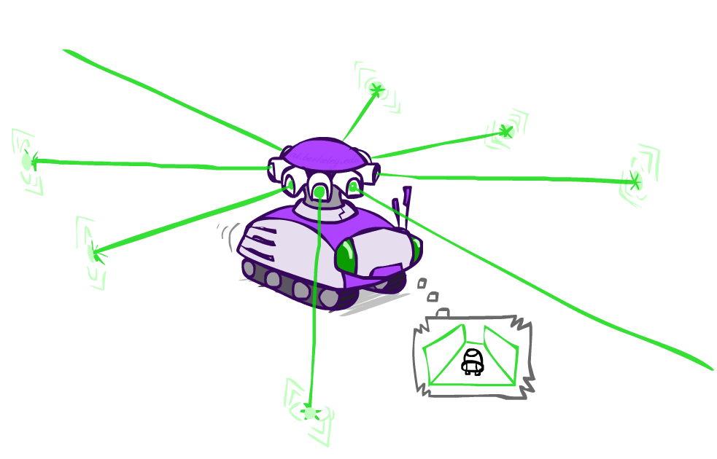
Example: Robot Localization
Example from Michael Pfeiffer
Prob
0
1
t=0
Sensor model: can read in which directions there is a wall, never more than 1 mistake
Motion model: may not execute action with small prob.

Slide 16
Example: Robot Localization
Prob
0
1
t=1
Lighter grey: was possible to get the reading, but less likely b/c required 1 mistake

Slide 17
Example: Robot Localization
Prob
0
1
t=2

Slide 18
Example: Robot Localization
Prob
0
1
t=3

Slide 19
Example: Robot Localization
Prob
0
1
t=4

Slide 20
Example: Robot Localization
Prob
0
1
t=5

Slide 21


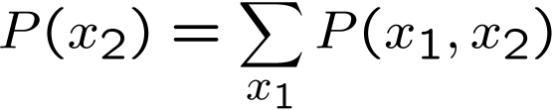

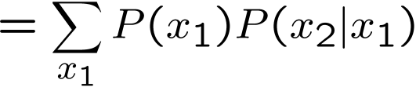

Inference: Base Cases
X₁
X₁
X₂
E₁

Slide 22

Passage of Time
Assume we have current belief P(X | evidence to date)
Then, after one time step passes:
Basic idea: beliefs get “pushed” through the transitions
With the “B” notation, we have to be careful about what time step t the belief is about, and what evidence it includes
X₁
X₂
Or compactly:
Notes:
TODO: intermediate step in derivation!

Slide 23
Observation
X₁
Assume we have current belief P(X | previous evidence):
Then, after evidence comes in:
Or, compactly:
E₁
Basic idea: beliefs “reweighted” by likelihood of evidence
Unlike passage of time, we have to renormalize
Notes:
Basic idea: beliefs “reweighted” by likelihood of evidence
Unlike passage of time, we have to renormalize

Slide 24
Example: Weather HMM
B’(+r) = 0.5
B’(-r) = 0.5
B’(+r) = 0.627
B’(-r) = 0.373
B(+r) = 0.5
B(-r) = 0.5
B(+r) = 0.818
B(-r) = 0.182
B(+r) = 0.883
B(-r) = 0.117
Rain₀
Rain₁
Rain₂
R_{t} | R_{t+1} | P(R_{t+1}|R_{t})
+r | +r | 0.7
+r | -r | 0.3
-r | +r | 0.3
-r | -r | 0.7
R_{t} | U_{t} | P(U_{t}|R_{t})
+r | +u | 0.9
+r | -u | 0.1
-r | +u | 0.2
-r | -u | 0.8
Umbrella₁
Umbrella₂
Notes:
demo

Slide 25

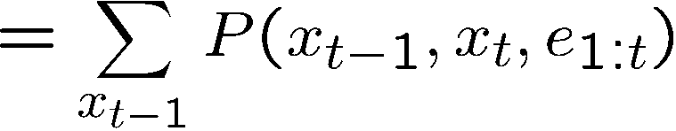
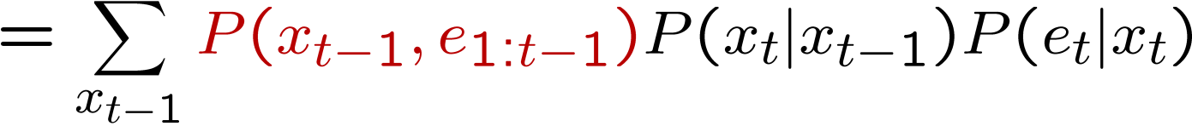
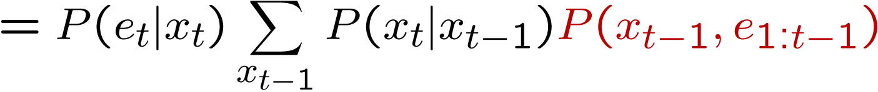
The Forward Algorithm
We are given evidence at each time and want to know
We can derive the following updates
We can normalize as we go if we want to have P(x|e) at each time step, or just once at the end…
Notes:
TODO: explain propto and it’s X_t, not X

Slide 26
Online Belief Updates
Every time step, we start with current P(X | evidence)
We update for time:
We update for evidence:
The forward algorithm does both at once (and doesn’t normalize)
X₁
X₂
X₂
E₂

Slide 27

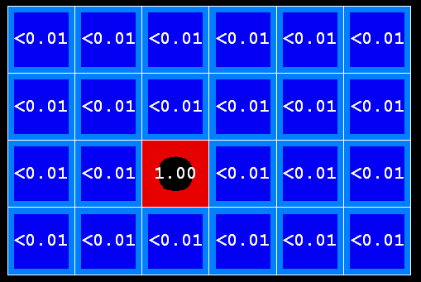
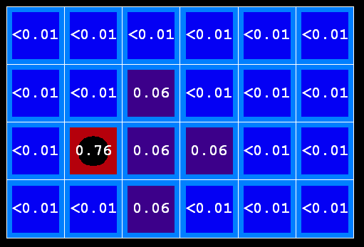
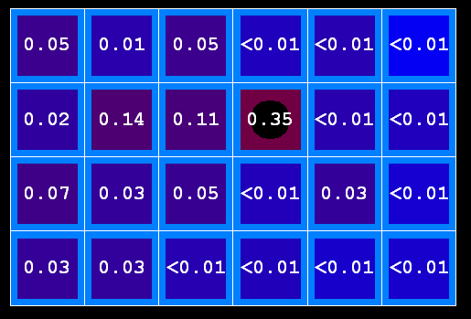
Example: Passage of Time
As time passes, uncertainty “accumulates”
(Transition model: ghosts usually go clockwise)
T = 1
T = 2
T = 5

Slide 28




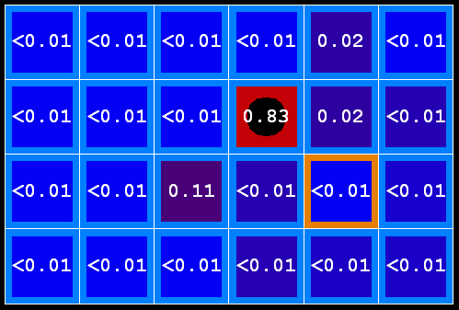
Example: Observation
As we get observations, beliefs get reweighted, uncertainty “decreases”
Before observation
After observation

Slide 29

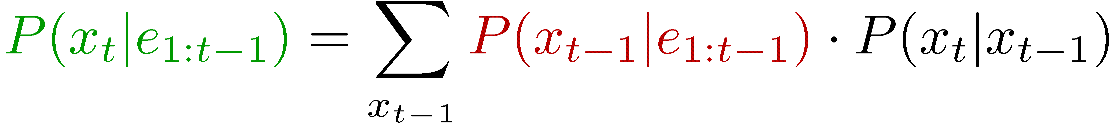

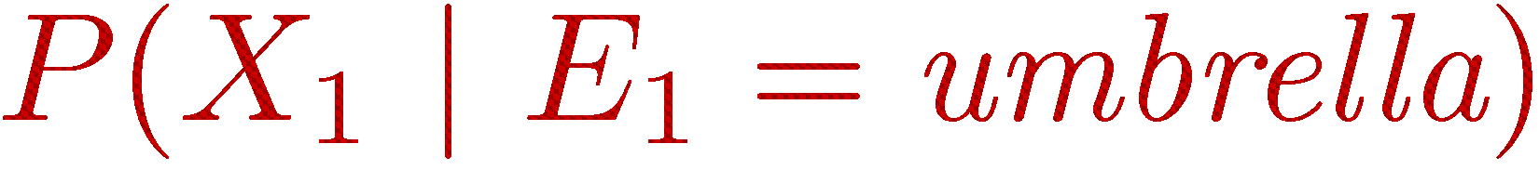
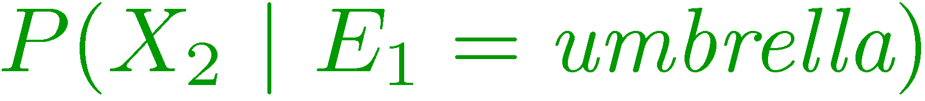
Filtering
Elapse time: compute P( X_{t} | e_{1:t-1} ) Observe: compute P( X_{t} | e_{1:t} )
Belief: <P(rain), P(sun)>
X₁
X₂
<0.5, 0.5>
Prior on X₁
<0.82, 0.18>
Observe
E₁
E₂
<0.63, 0.37>
Elapse time
<0.88, 0.12>
Observe
[Demo: Ghostbusters Exact Filtering (L15D2)]

Slide 30
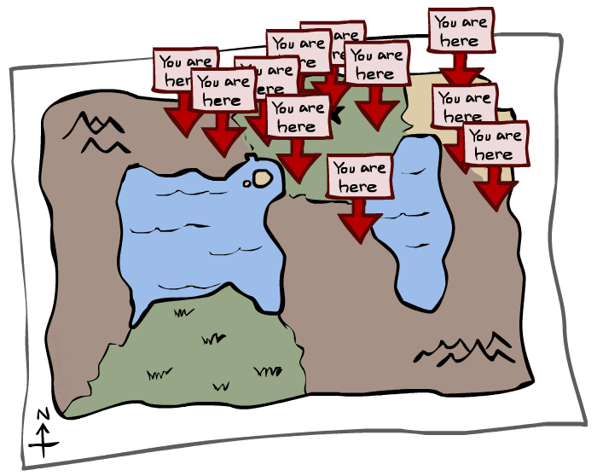
Particle Filtering

Slide 31
Particle Filtering
Filtering: approximate solution
Sometimes |X| is too big to use exact inference
|X| may be too big to even store B(X)
E.g. X is continuous
Solution: approximate inference
Track samples of X, not all values
Samples are called particles
Time per step is linear in the number of samples
But: number needed may be large
In memory: list of particles, not states
This is how robot localization works in practice
Particle is just new name for sample
0.0
0.1
0.0
0.0
0.0
0.2
0.0
0.2
0.5

Slide 32
Representation: Particles
Our representation of P(X) is now a list of N particles (samples)
Generally, N << |X|
Storing map from X to counts would defeat the point
P(x) approximated by number of particles with value x
So, many x may have P(x) = 0!
More particles, more accuracy
For now, all particles have a weight of 1
Particles:
(3,3)
(2,3)
(3,3)
(3,2)
(3,3)
(3,2)
(1,2)
(3,3)
(3,3)
(2,3)

Slide 33

Particle Filtering: Elapse Time
Each particle is moved by sampling its next position from the transition model
This is like prior sampling – samples’ frequencies reflect the transition probabilities
Here, most samples move clockwise, but some move in another direction or stay in place
This captures the passage of time
If enough samples, close to exact values before and after (consistent)
Particles:
(3,3)
(2,3)
(3,3)
(3,2)
(3,3)
(3,2)
(1,2)
(3,3)
(3,3)
(2,3)
Particles:
(3,2)
(2,3)
(3,2)
(3,1)
(3,3)
(3,2)
(1,3)
(2,3)
(3,2)
(2,2)

Slide 34


Particle Filtering: Observe
Particles:
(3,2)
(2,3)
(3,2)
(3,1)
(3,3)
(3,2)
(1,3)
(2,3)
(3,2)
(2,2)
Slightly trickier:
Don’t sample observation, fix it
Similar to likelihood weighting, downweight samples based on the evidence
As before, the probabilities don’t sum to one, since all have been downweighted (in fact they now sum to (N times) an approximation of P(e))
Particles:
(3,2) w=.9
(2,3) w=.2
(3,2) w=.9
(3,1) w=.4
(3,3) w=.4
(3,2) w=.9
(1,3) w=.1
(2,3) w=.2
(3,2) w=.9
(2,2) w=.4

Slide 35
Particle Filtering: Resample
Rather than tracking weighted samples, we resample
N times, we choose from our weighted sample distribution (i.e. draw with replacement)
This is equivalent to renormalizing the distribution
Now the update is complete for this time step, continue with the next one
Particles:
(3,2) w=.9
(2,3) w=.2
(3,2) w=.9
(3,1) w=.4
(3,3) w=.4
(3,2) w=.9
(1,3) w=.1
(2,3) w=.2
(3,2) w=.9
(2,2) w=.4
(New) Particles:
(3,2)
(2,2)
(3,2)
(2,3)
(3,3)
(3,2)
(1,3)
(2,3)
(3,2)
(3,2)

Slide 36
Recap: Particle Filtering
Particles: track samples of states rather than an explicit distribution
Elapse
Weight
Resample
Particles:
(3,3)
(2,3)
(3,3)
(3,2)
(3,3)
(3,2)
(1,2)
(3,3)
(3,3)
(2,3)
Particles:
(3,2)
(2,3)
(3,2)
(3,1)
(3,3)
(3,2)
(1,3)
(2,3)
(3,2)
(2,2)
Particles:
(3,2) w=.9
(2,3) w=.2
(3,2) w=.9
(3,1) w=.4
(3,3) w=.4
(3,2) w=.9
(1,3) w=.1
(2,3) w=.2
(3,2) w=.9
(2,2) w=.4
(New) Particles:
(3,2)
(2,2)
(3,2)
(2,3)
(3,3)
(3,2)
(1,3)
(2,3)
(3,2)
(3,2)
[Demos: ghostbusters particle filtering (L15D3,4,5)]

Slide 37
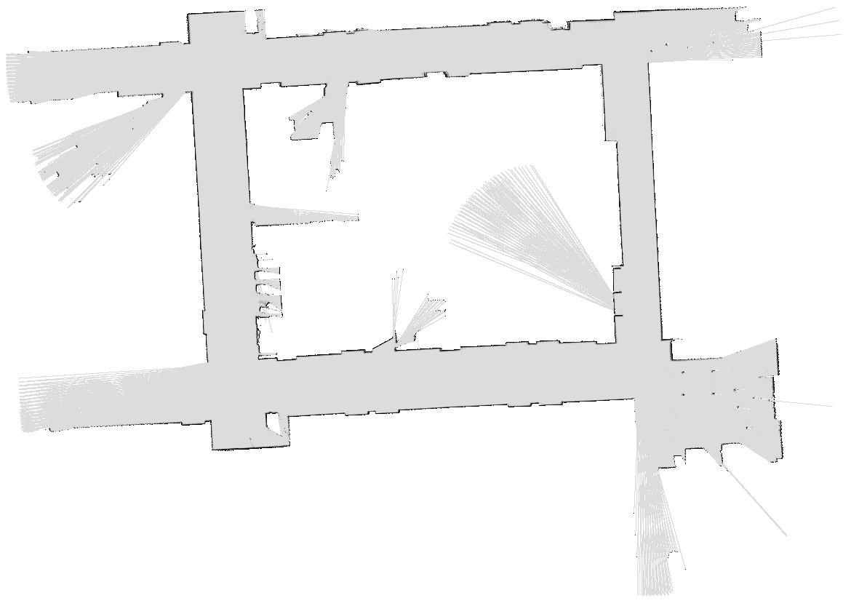

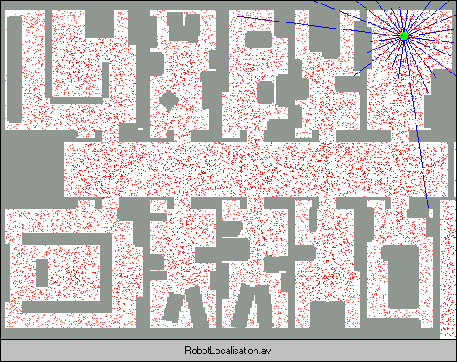
More Demos!

Slide 38
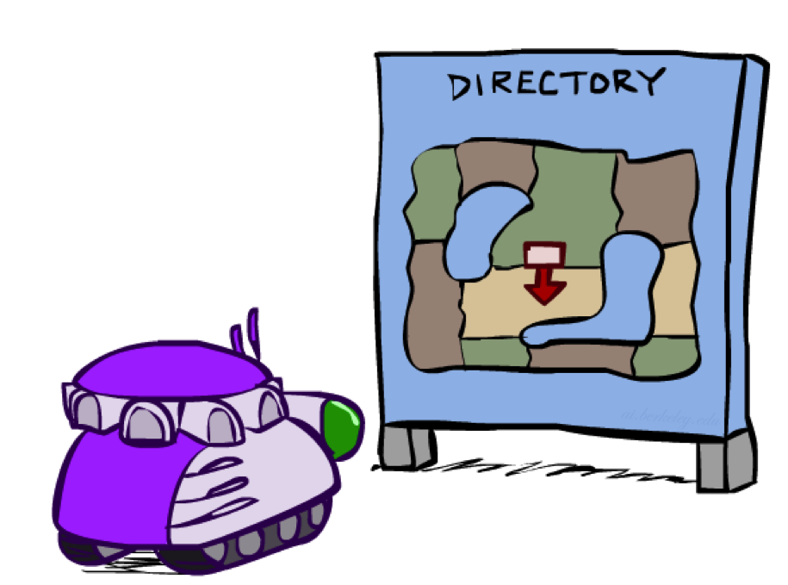
Robot Localization
In robot localization:
We know the map, but not the robot’s position
Observations may be vectors of range finder readings
State space and readings are typically continuous (works basically like a very fine grid) and so we cannot store B(X)
Particle filtering is a main technique

Slide 39
Robot Localization
In robot localization:
We know the map, but not the robot’s position
Observations may be vectors of range finder readings
State space and readings are typically continuous (works basically like a very fine grid) and so we cannot store B(X)
Particle filtering is a main technique

